Slide 1
ONE AXIS DRILL PROJECT
PROGRESS

Slide 2
OBJECTIVES TO BE MET:
Full analysis of existing physical model done by previous groups.
Mechanical design of the physical model in Solid works software.
Finite element analysis in Abaqus and Ansys
Circuit design in Proteus and Kicad
Program using STM32 chip
Analysis and optimization.

Slide 3
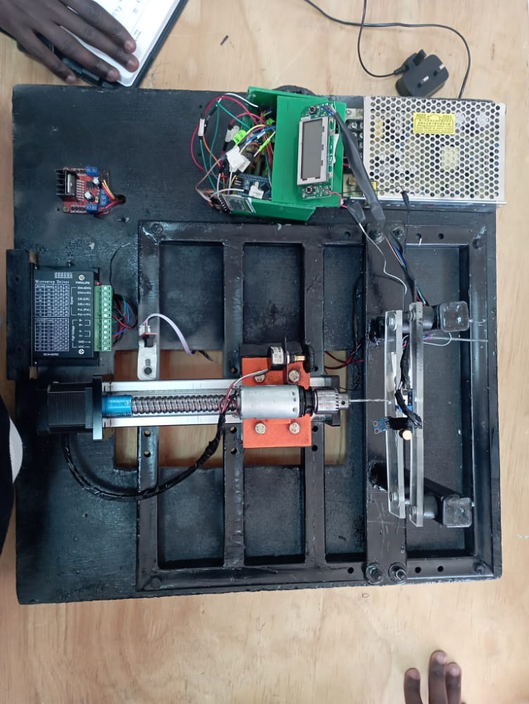
1. INTERACTION WITH EXISTIND PHYSICAL MODEL

Slide 4
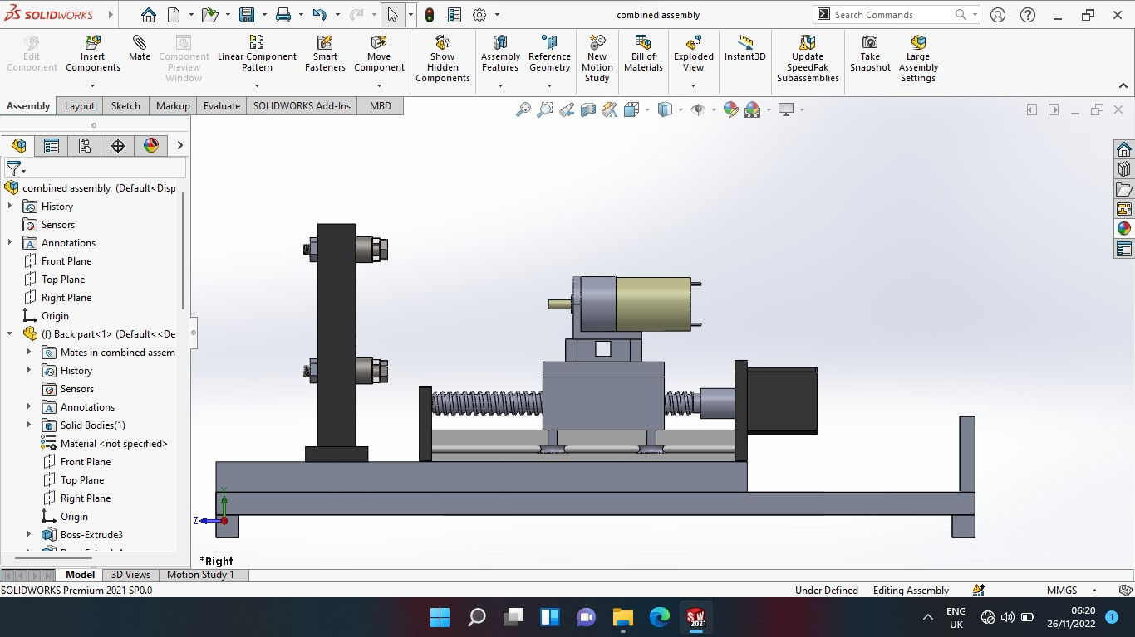
2. MECHANICAL DESIGN IN SOLIDWORKS

Slide 5
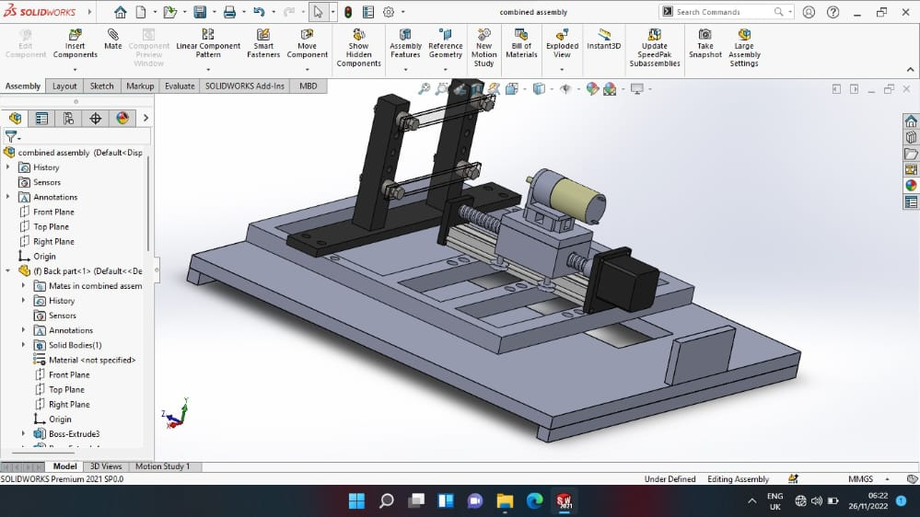

Slide 6
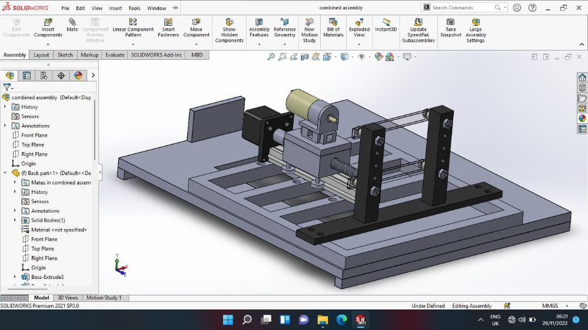

Slide 7
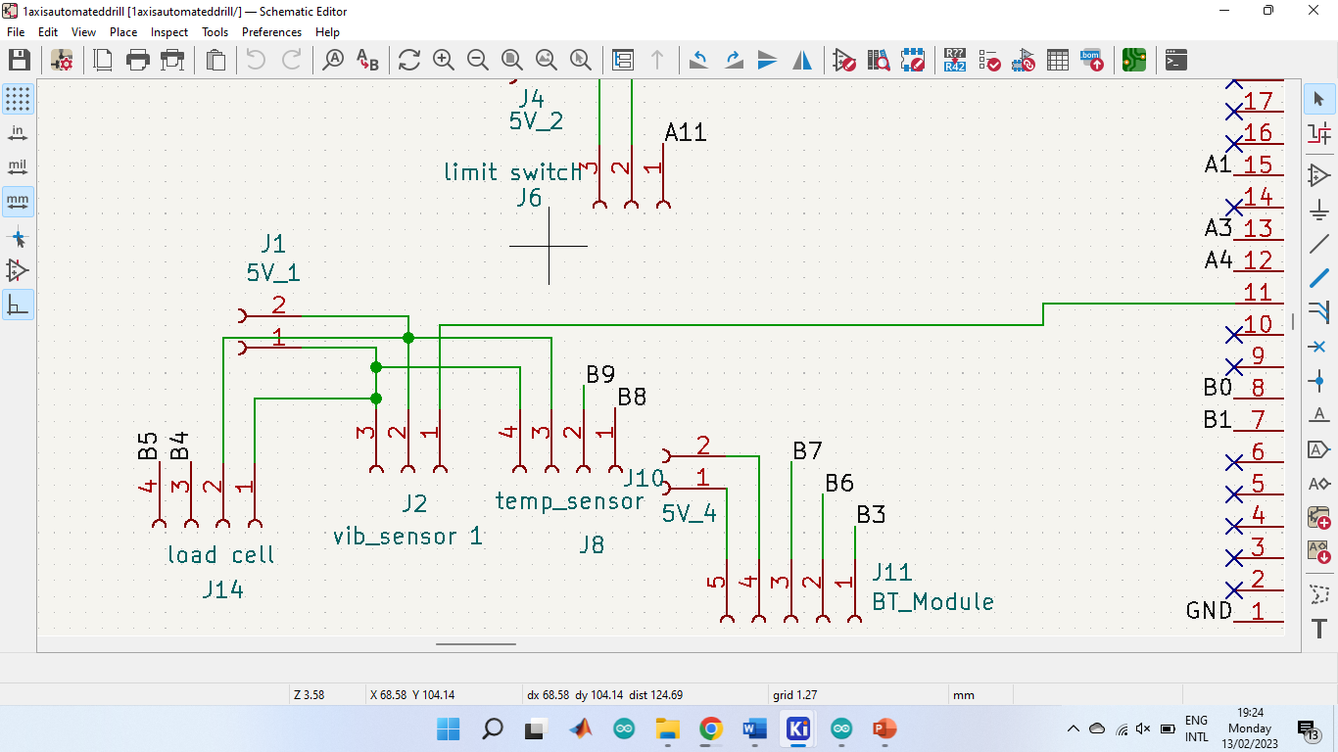
3. CIRCUIT DESIGN IN KICAD

Slide 8
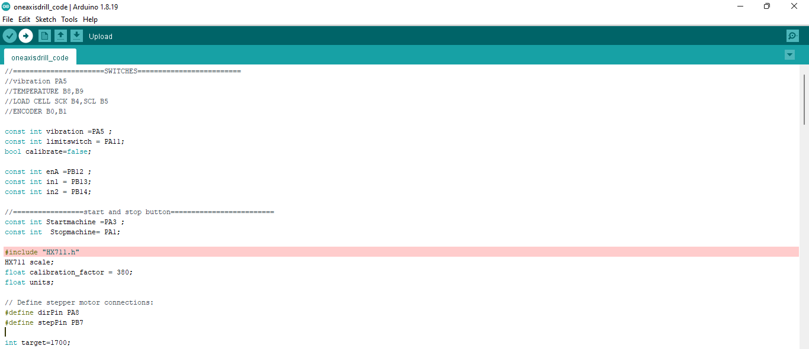
3. CODE SECTION

Slide 9
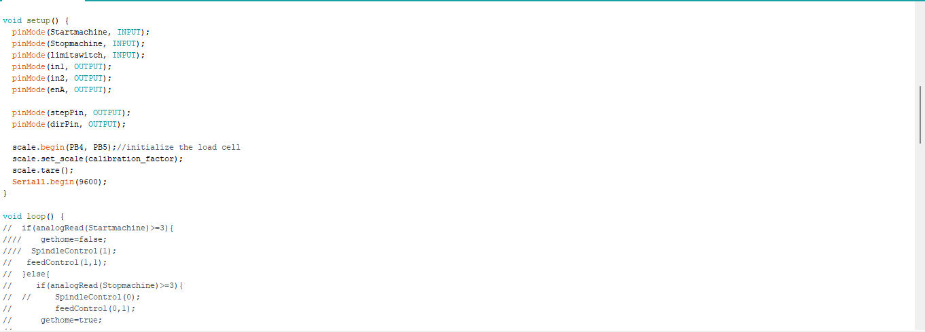

Slide 10
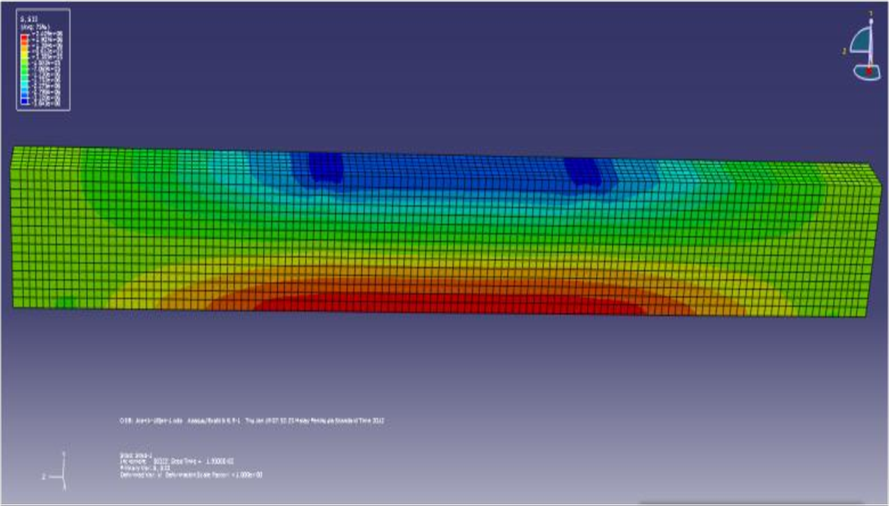
4. FINITE ELEMENT ANALYSIS IN ABAQUS

Slide 11
THINGS WE DIDN’T ACCOMPLISH
Deeper dive into finite element analysis in Abaqus and Ansys.
Full circuit design and simulation.
FUTURE PLAN DURING ATTACHMENT PERIOD
Modification of Solid works mechanical design.
Interaction with Abaqus and Ansys.
Circuit research, design and analysis in Proteus and Kicad.
Code optimization

